Slide 1



Slide 2

Testing is checking the expected results with actual results.

Slide 3

The testing performed by the programmer on his own piece of code is called as unit testing.

Slide 4
Why Unit Testing
Reduces bug ratio and time consumption.
Possible to identify problems earlier.
Changes are possible without reflecting other modules.
Makes Design and Documentation simple.
Integration of modules becomes easier
Quality of Code.

Slide 5
Best Unit Testing Tools For Java
J Unit.
Test NG.
Mockito.
Power mock.
Etc..

Slide 6
JUnit
JUnit is a unit testing framework designed for the Java programming language. JUnit has played an important role in the development of test-driven development frameworks. It is one of a family of unit testing frameworks which is collectively known as the xUnit that originated with SUnit.

Slide 7
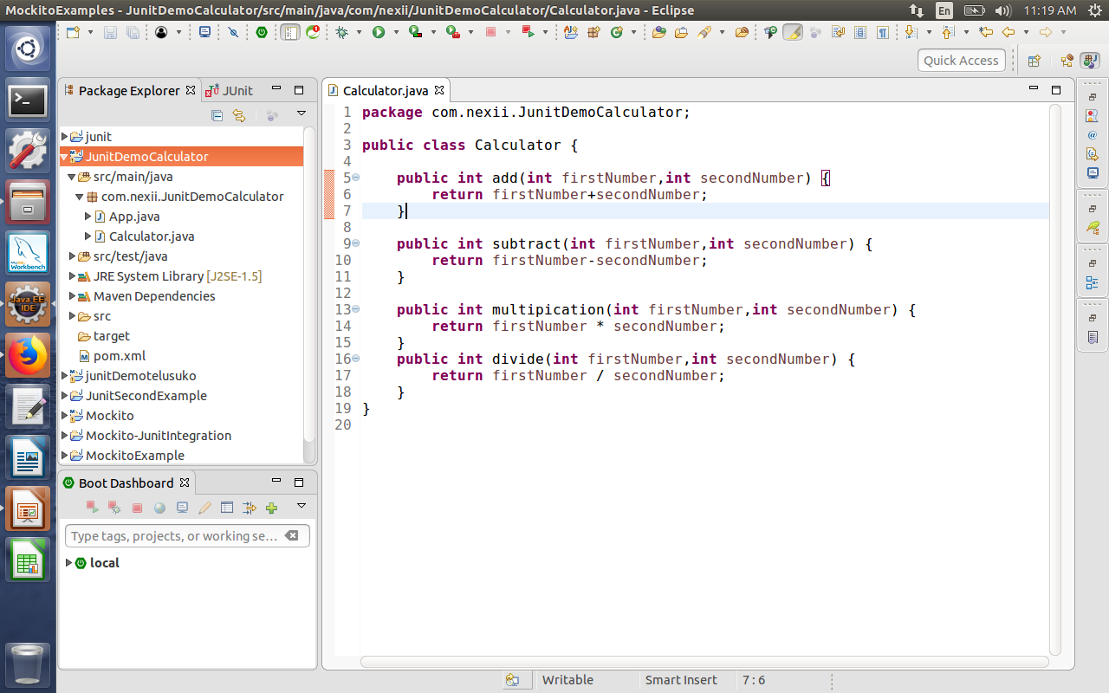
Junit Example:-

Slide 8
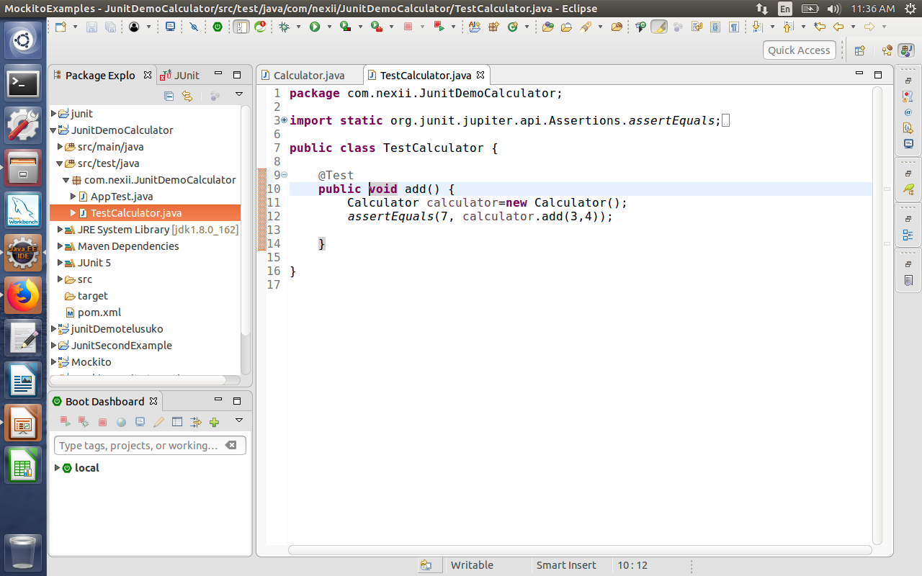

Slide 9
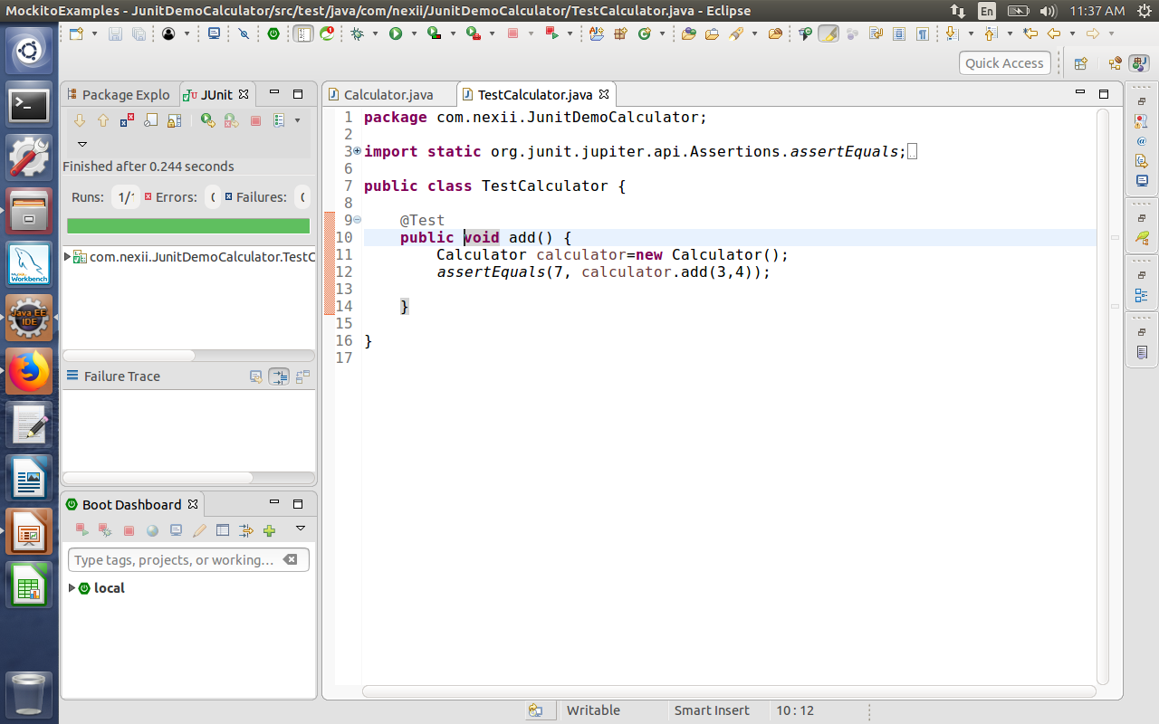
Out Put:-

Slide 10
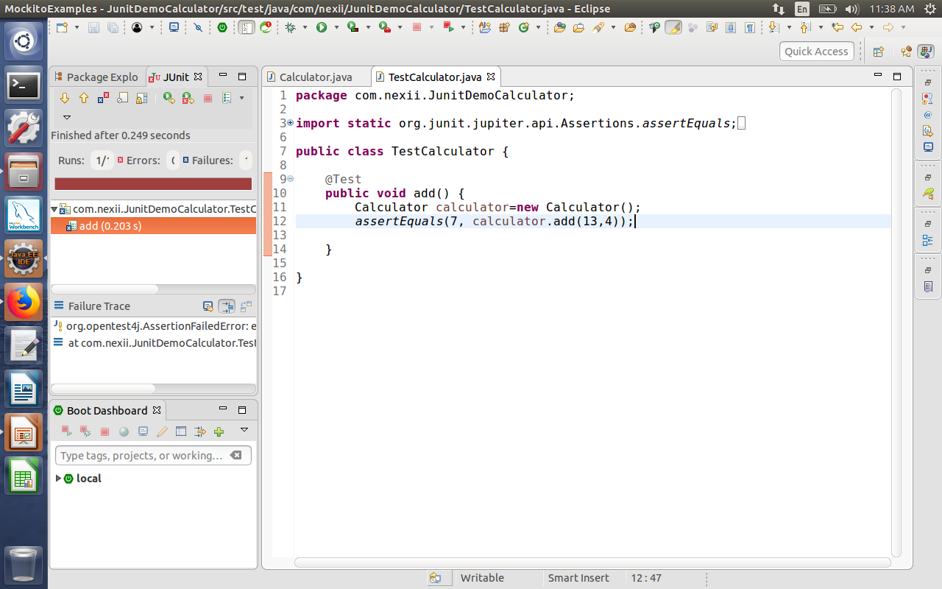

Slide 11
Junit Draw Backs:
1).If Our Application Connected With Cloud Service It will Take Time to Run The Application.
2).No Dependency Test.

Slide 12
Mockito
1).Mockito is a mocking framework, JAVA-based library that is used for effective unit testing of JAVA applications.
2).Mockito is used to mock interfaces so that a dummy functionality can be added to a mock interface that can be used in unit testing..

Slide 13
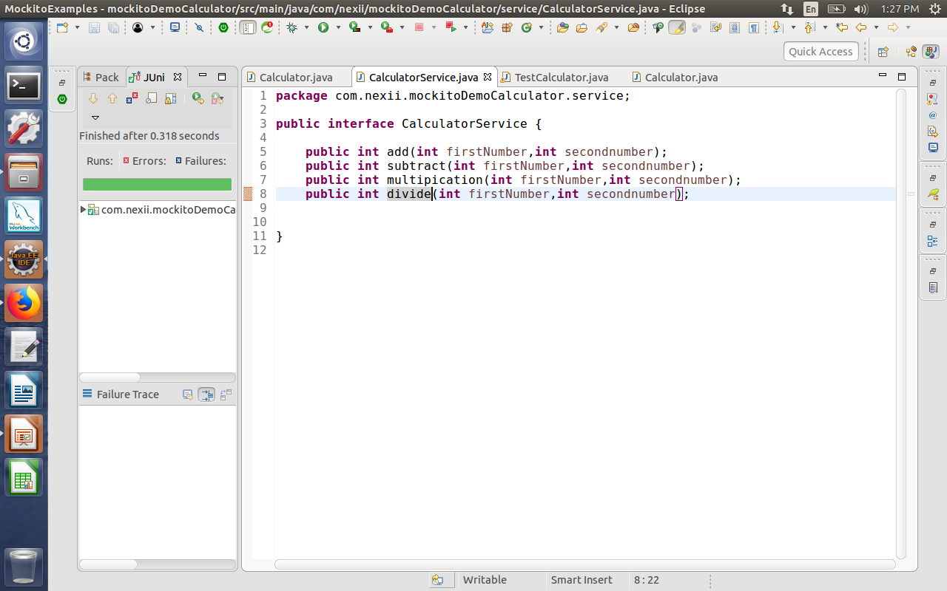
Mockito Example:-

Slide 14
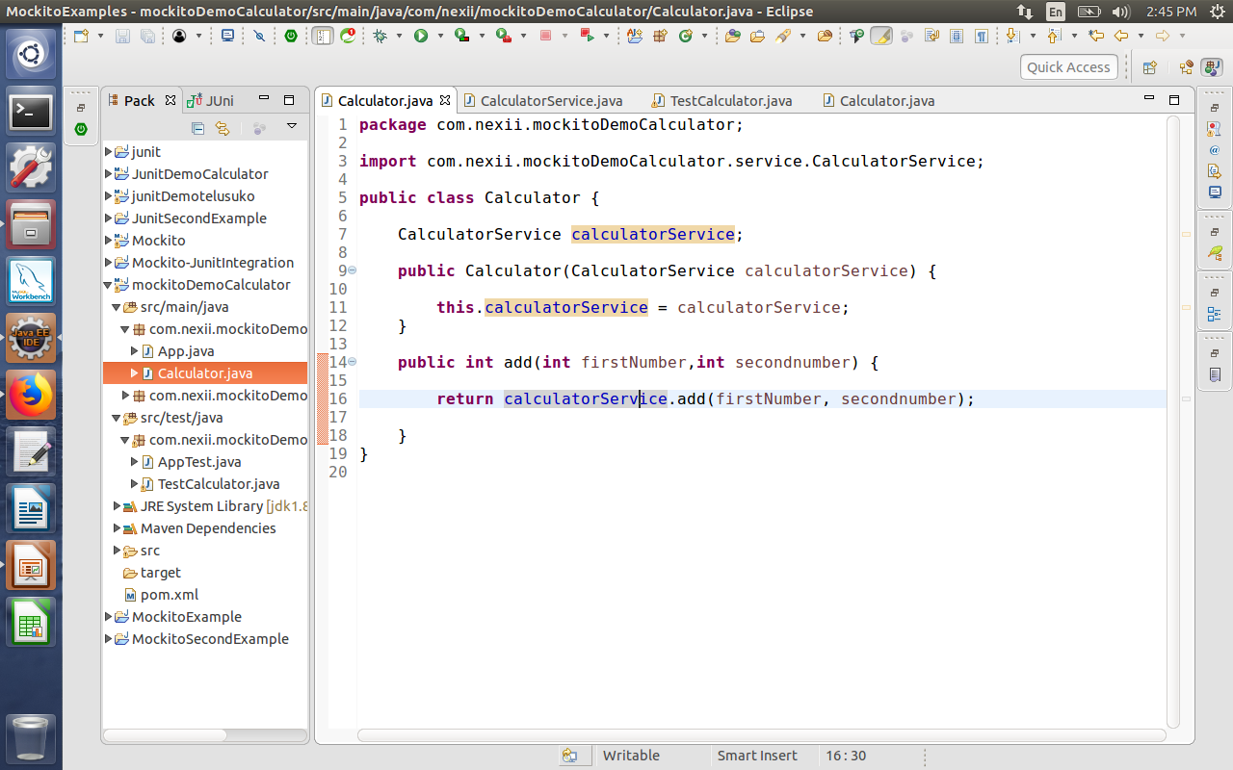
Calculator Class:-

Slide 15
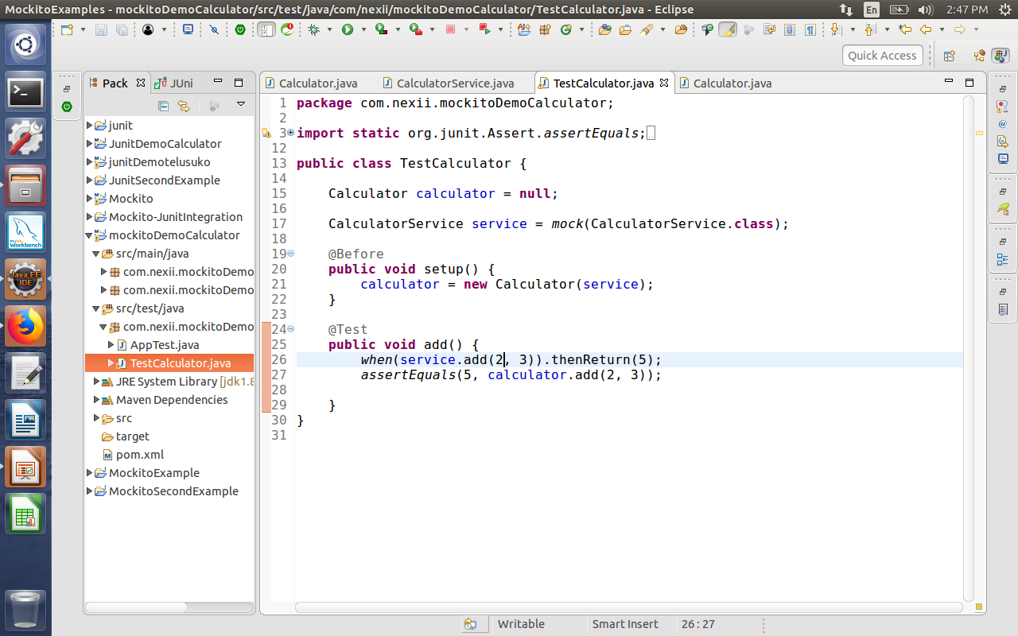
Calculator Test Class

Slide 16
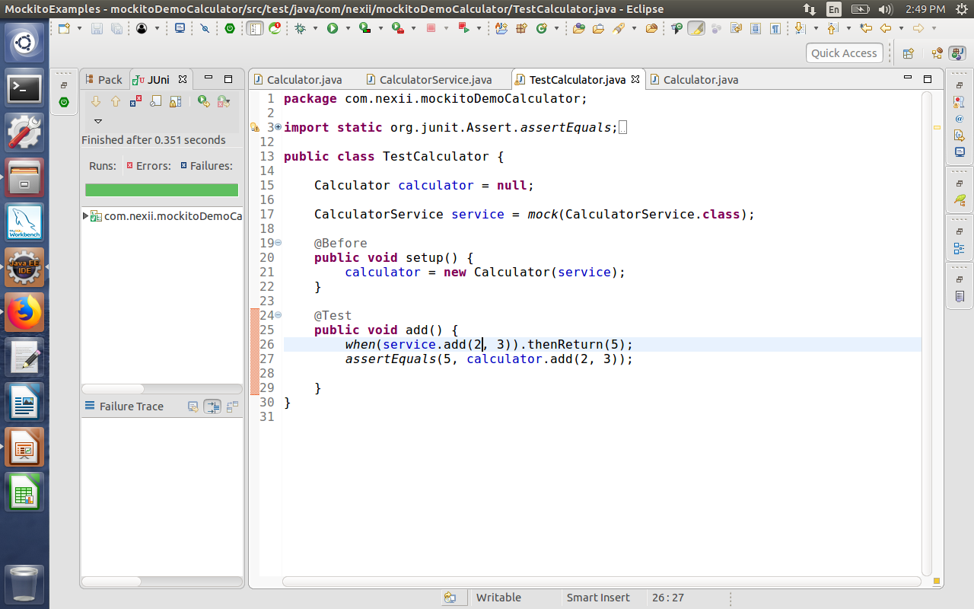
Out put:

Slide 17
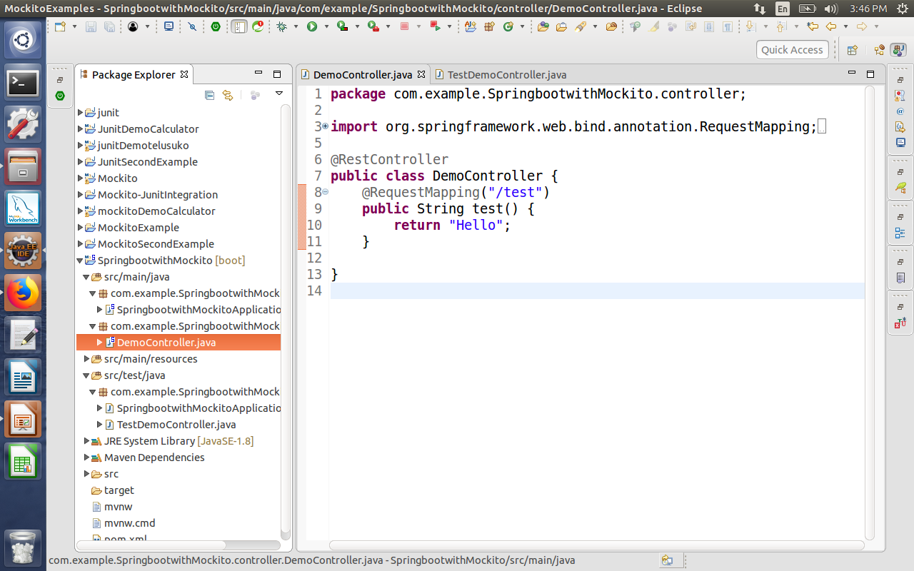
Spring Boot with Mockito:-

Slide 18
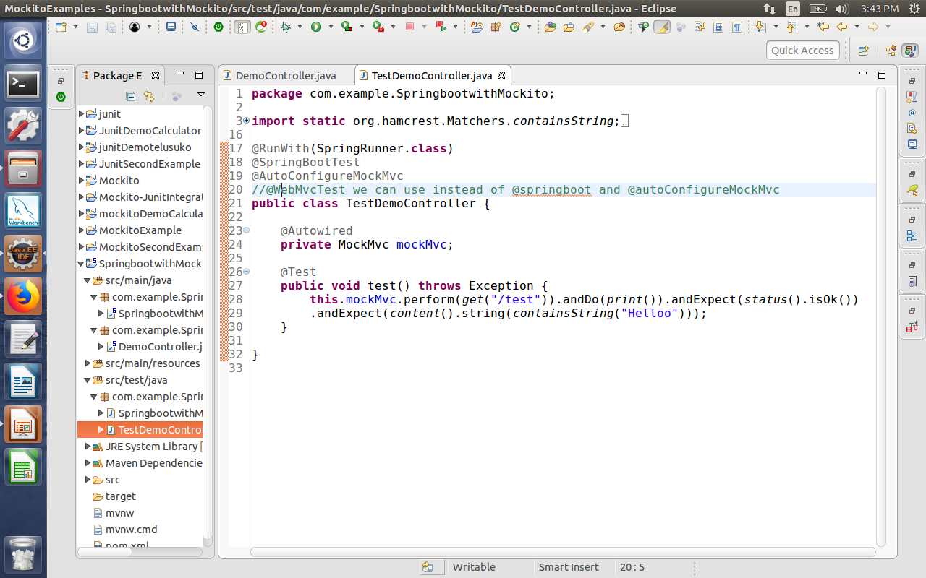
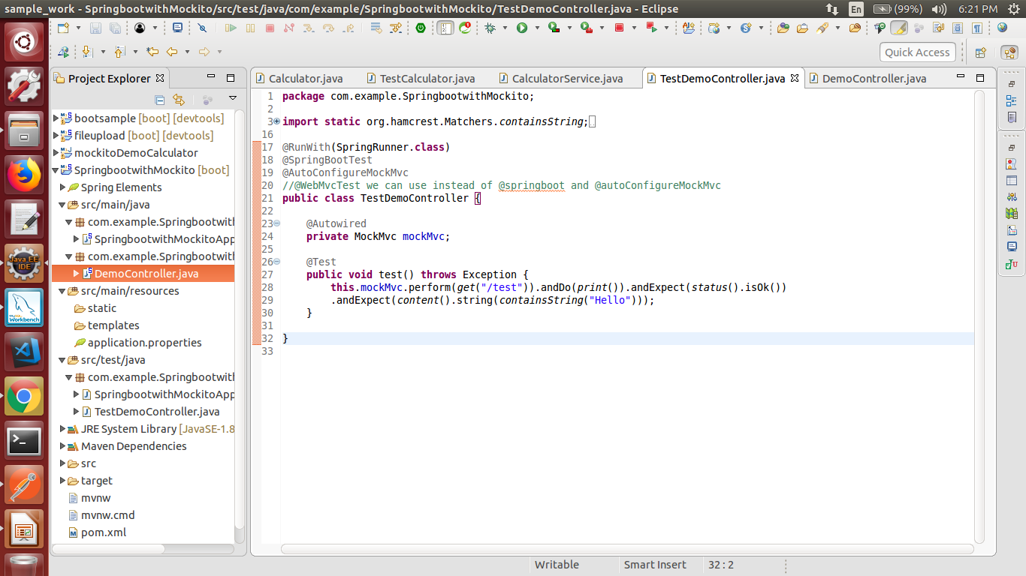
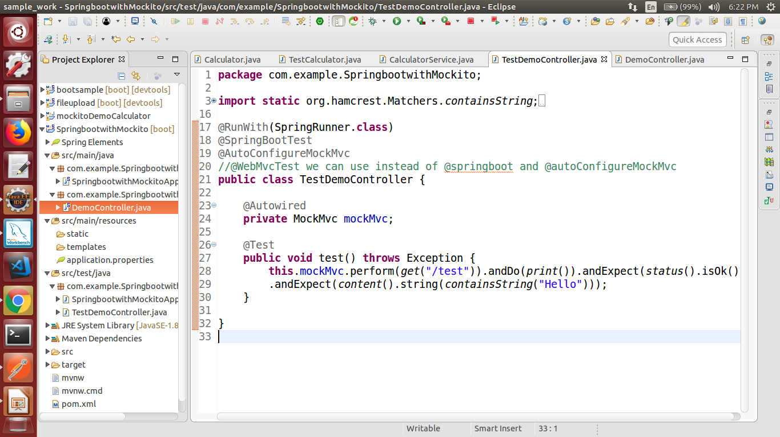
TestDemoController-

Slide 19
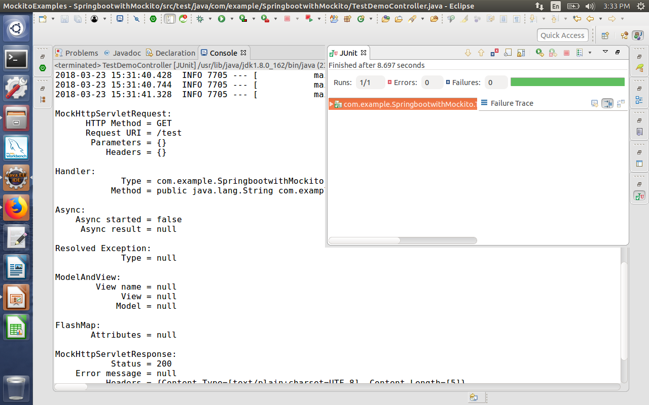
TestDemoController

Slide 20
        THANK YOU

